Slide 1

Stock Market Prediction Using Sequential Log-Power Normalization and Ridge Regression

Slide 2
Department of Computer Science and Engineering
Stock Market Prediction Using Sequential Log-Power
Normalization and Ridge Regression
PRESENTED BY
Cherukuri Thirumala Malyadri 22471A0509
Challa Rohith 22471A0507
Mitta Venu 22471A0537
Chevuri Chandu 22471A0511
Under the Guidance of,
Kolisetty Soma Sekhar _{Ph.D,}
Assistant Professor,
Department of Computer Science and Engineering,
Narasaraopeta Engineering College (Autonomous),
Narasaraopet- 522 601.

Slide 3
OUTLINE
Abstract
Introduction
Literature Survey
Research Gaps
Problem Statement
Objectives
Block Diagram / Flow Diagram
Methodology
Implementation
Results and Analysis
Conclusion & Future Scope
References
Question and Answers
Acknowledgements

Slide 4
ABSTRACT
Stock price prediction is a challenging task due to volatility, noise, and non-linearity in financial time series. Traditional statistical models often fail to capture these irregularities, while deep learning approaches, although powerful, are computationally expensive and lack interpretability for practical financial decision-making.

Slide 5
INTRODUCTION
Financial markets exhibit highly dynamic, noisy, and unpredictable behavior influenced by global, economic, and psychological factors. Predicting stock movements is difficult because price fluctuations often demonstrate non-stationarity, volatility clustering, and random variations. Traditional forecasting models such as ARIMA and statistical regression approaches offer limited capability due to their inability to handle skewed distributions, variance irregularities, and correlated stock attributes.

Slide 6
LITERATURE SURVEY
No | Title | Author | Journal Name & Year | Methodology Adapted | Key Findings | Gaps
1 | Driver Fatigue Detection Based on Eye States With Pupil and Iris Segmentation | Hariharan P., Surya N. | American Journal of Psychiatric Rehabilitation, 2025 | U-Net for segmentation + decision network for eye state | Achieved 96.72% accuracy; effective real-time | Small dataset; requires more diverse
2 | Efficient Driver Drunk Detection by Sensors: A Manifold Learning-Based Anomaly Detector | Huang J., Ding W., Yu G. | Alexandria Engineering Journal, 2025 | t-SNE for feature reduction + Isolation Forest for anomaly detection | AUC ≈ 95%; outperformed PCA, ICA, EE, | Small dataset; requires more diverse
3 | Fusion of EEG and Eye Blink Analysis for Detection of Driver Fatigue | Kang M. et al. | IEEE/CVF Winter Conf. on Applications of Computer Vision, 2025 | Single-channel EEG + eye blink interval + DWT + feature selection + AdaBoost | 88.4% accuracy, 90.2% sensitivity; usable with portable EEG headbands | Multi-channel EEGs perform better; limited real-world use
4 | Novel Transfer Learning Approach for Driver Drowsiness Detection Using Eye Movement Behavior | Pehlivanoğlu M. K. et al. | Eur. Phys. J. Spec. Top., 2025 | VGG-16 feature extraction + LGBM classification + k-fold validation | Achieved 99% accuracy; real-time detection in | Synthetic dataset; lacks real-world
5 | A Systematic Review on Driver Drowsiness Detection Using Eye Activity Measures | Bai R., Xu G., Shi Y. | Int. Conf. on Health Big Data, 2025 | Systematic PRISMA-based review of 41 | Reported 95-99% accuracy in various | Lack of real-world test validation; small sample

Slide 7
RESEARCH GAPS
Stock prices are skewed, noisy, and heteroscedastic, making direct regression inaccurate.
Prior studies use either log or power transformation, but not a combined sequential approach for stronger variance stabilization.
LSTM and neural networks perform well but are computationally expensive, hard to interpret, and not suitable for lightweight decision systems.
Many approaches focus on architecture improvement rather than demonstrating how data conditioning improves prediction performance.
Stock features such as Open, High, Low, and Close are highly correlated, yet most models do not manage these dependencies effectively.

Slide 8
PROBLEM STATEMENT
Financial time-series data such as stock prices exhibit high variance, skewed distribution, noise, and multicollinearity between features like Open, High, Low, and Close values.
Traditional statistical models struggle to learn effectively from such unstable data, while deep learning approaches — although accurate — are computationally expensive, data-hungry, and difficult to interpret.
Existing prediction models typically use single-stage normalization, which is insufficient for stabilizing variance, leading to poorer regression performance and reduced generalization ability.

Slide 9
OBJECTIVES
By applying sequential log and Yeo–Johnson power transformations to reduce skewness and heteroscedasticity.
As a lightweight and interpretable forecasting model capable of handling multicollinearity among financial variables.
Against baseline models such as Linear Regression, Support Vector Regression, Neural Networks, and deep learning approaches.

Slide 10
METHODOLOGY
Data Collection
The dataset used in this study consists of historical stock market records collected from publicly available financial databases and exchange sources. Each entry includes fundamental trading attributes such as Open price, High price, Low price, Close price, and traded Volume, which represent the daily behavior of a stock. These values capture essential fluctuations in market activity and form the core predictors for forecasting models.

Slide 11
Baseline Model Development
A basic neural network workflow is implemented first to act as a benchmark. It includes:
Normalization
Training a dense neural model
Prediction and evaluation This establishes reference performance for comparison.

Slide 12
Data Preprocessing
Raw financial data is skewed and unstable; therefore:
Date values are converted into numerical form
Categorical fields are removed
Missing values are handled

Slide 13
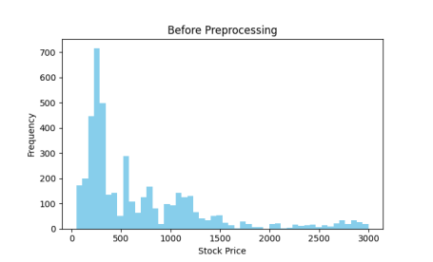
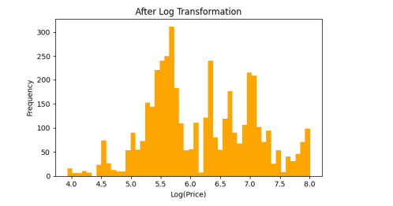
Before and After Preprocessing

Slide 14
Variance Stabilization Pipeline
To create well-behaved input data, a two-stage transformation is applied:
✔ a) Logarithmic Transformation
Compresses extreme values, reduces skewness, and stabilizes fluctuations. Improves linear model conditioning.
✔ b) Yeo–Johnson Power Transformation
Further stabilizes variance and normalizes feature distribution (works for both positive and negative values).

Slide 15
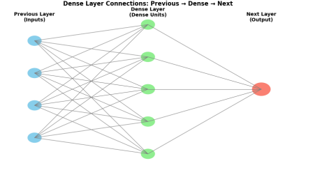
Dense layer connectivity

Slide 16
Standardization and Imputation
Feature scaling using StandardScaler ensures:
Zero mean
Unit variance
Median imputation is applied to handle any remaining missing values

Slide 17
Model Training
a) Ridge Regression
Chosen for its ability to:
Handle multicollinearity among stock attributes
Prevent overfitting through regularization
A mild penalty parameter (α = 0.1) ensures stable learning.
b) Comparison Neural Network
A dense network is also trained for comparative study.

Slide 18
Evaluation
Models are tested using:
R² score
Mean Squared Error (MSE)
Mean Absolute Error (MAE)
Predictions are visualized against actual stock prices for performance interpretation.

Slide 19
IMPLEMENTATION
Hardware Specifications:
Processor : Intel Core i7Gen or above
RAM : 8GB (4 GB usable)
System Type : 64-bit operating system
Software Specifications:
Operating System : Windows 11 or above
Coding Language : Python
Python Distribution: Google COLAB

Slide 20
PERFORMANCE ANALYSIS
The proposed prediction model was evaluated on multiple historical stock datasets to assess forecasting accuracy and generalization capability. After sequential log–power normalization, Ridge Regression achieved significantly improved statistical stability, allowing reliable trend learning even in highly volatile stock series.

Slide 21
RESULTS & ANALYSIS
Overall, the analysis confirms that the log–power normalization pipeline significantly strengthens stock prediction accuracy, making Ridge Regression a lightweight, interpretable, and highly reliable forecasting model suitable for financial decision support.

Slide 22
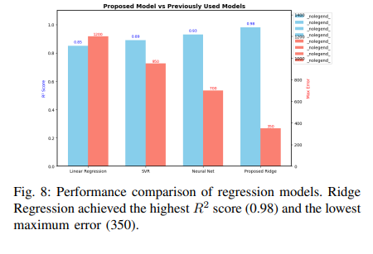
PROPOSED MODEL VS PREVIOUSLY USED MODELS

Slide 23
CONCLUSION and FUTURE SCOPE
This work presents an efficient and interpretable stock price prediction framework that integrates sequential log–power variance stabilization with Ridge Regression.
Incorporating more input variables, such as moving averages, financial sentiment, currency trends, and macroeconomic indicators.

Slide 24
REFERENCES
A. E. Hoerl and R. W. Kennard, “Ridge Regression: Applications to Stock Price Prediction,” Technometrics, vol. 12, no. 1, pp. 55–67, 1970..
T. Zhang and Y. Xu, “A Comprehensive Study on Log and Power Transformations for Time Series Forecasting,” IEEE Access, vol. 10, pp. 12134–12145, 2022.

Slide 25

QUESTIONS and ANSWERS

Slide 26

ACKNOWLEGEMENTS

